Slide 1

Daily Inspiration

Slide 2
Today
Intro
Linear regression, gradient descent
Bias and variance, cross-validation, learning curves Linear algebra primer
■
■
■
■

Slide 3
Who am I?
Some random guy off the streets
Studied Biology, then Molecular and Cellular Life Sciences with Bioinformatics profile, doing mainly ML. Homegrown at UU.
■
■

Slide 4
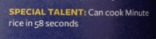
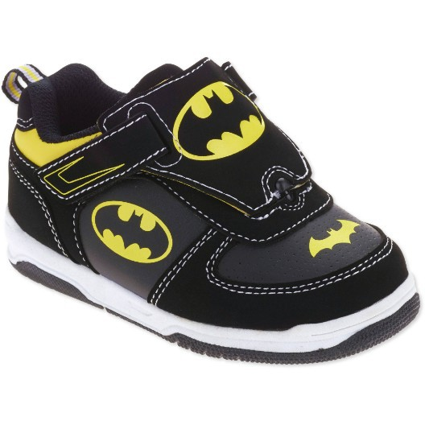
Who am I?
Some random guy off the streets
Studied Biology, then Molecular and Cellular Life Sciences with Bioinformatics profile, doing mainly ML. Homegrown at UU.
Hidden talent:
Can sing Tom Lehrer’s Elements Song (used to, anyway)
■
■
■
I can also tie my own shoes
■

Slide 5
Why am I teaching this?
I don’t know man, they told me to so I did it!
■

Slide 6
Why am I teaching this?
I don’t know man, they told me to so I did it! Are you good at ML?
■
■
–
Like good good? No.
Do you know more about ML than us?
■
–
Maybe? I sure hope so.
This doesn’t help your credibility, you know
■
–
Sorry guys.

Slide 7

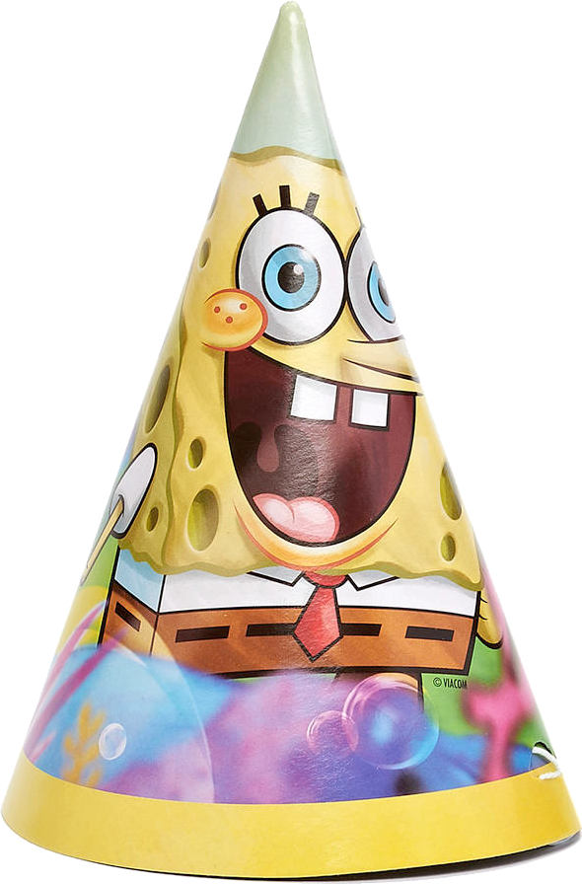
Why am I teaching this?

Slide 8
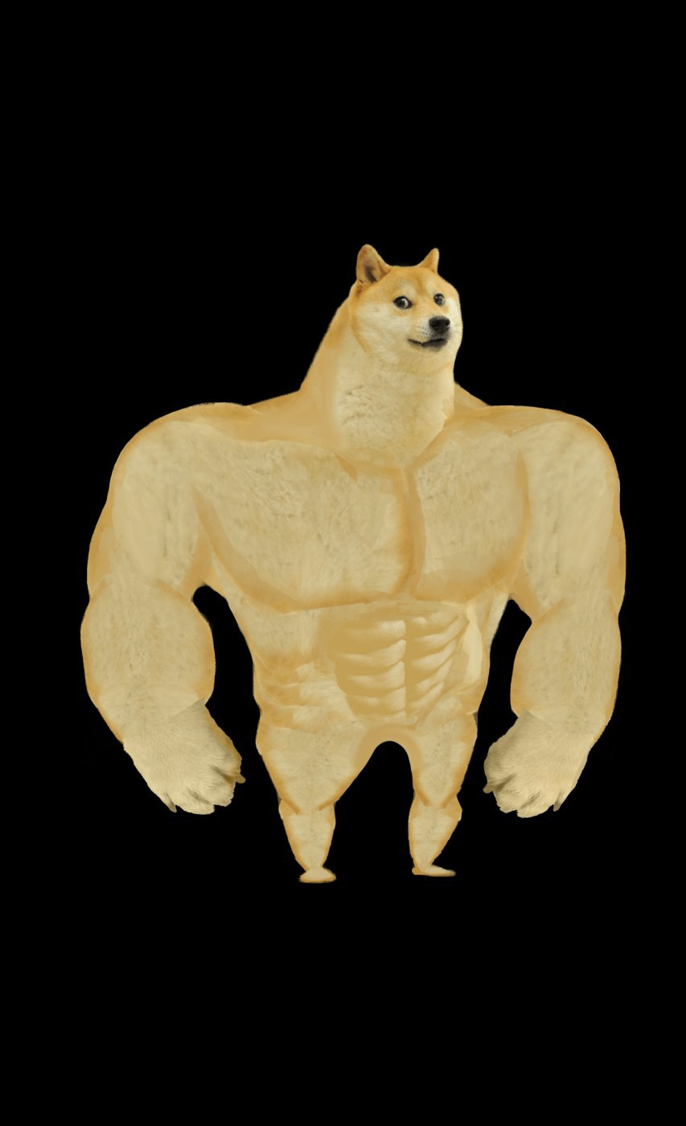
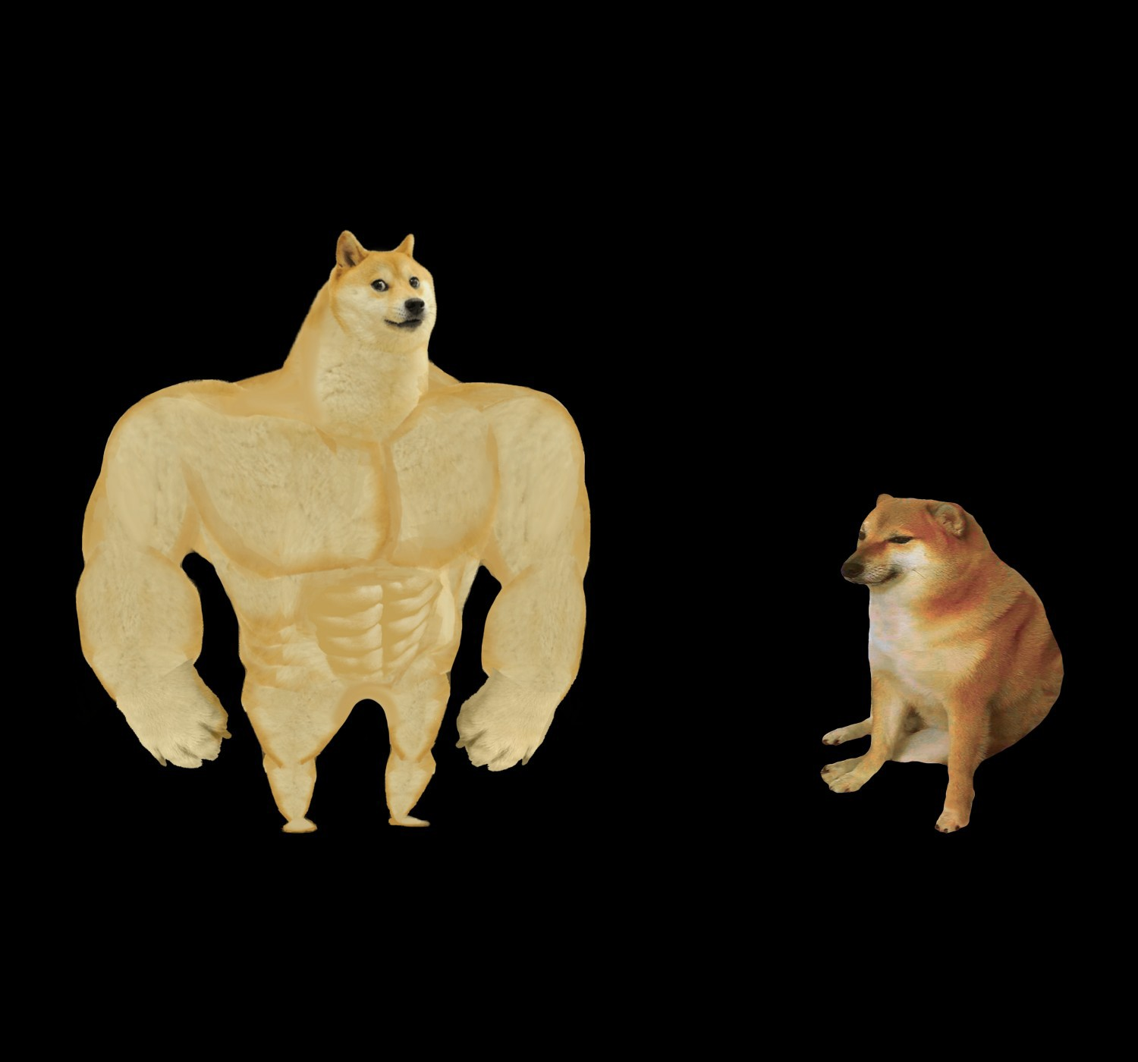
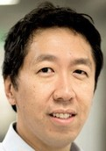


Real MVPs
Andrew Ng, Coursera ML guru
Jeroen de Ridder, resident ML maestro UMCU
Dieter Stoker, Some rando off the streets

Slide 9
Course content: what I hope to teach you
What is ML? Cost functions, gradient descent, generalisation, bias and variance.
Week 1: low-level understanding: able to implement linear regression, logistic regression, neural networks, clustering and PCA yourself using numpy in Python.
Week 2: modern ML library (scikit-learn) workflow (one day), + a hands-on project (~2 days). Written exam about lecture and practical concepts at the end.
■
■
■

Slide 10
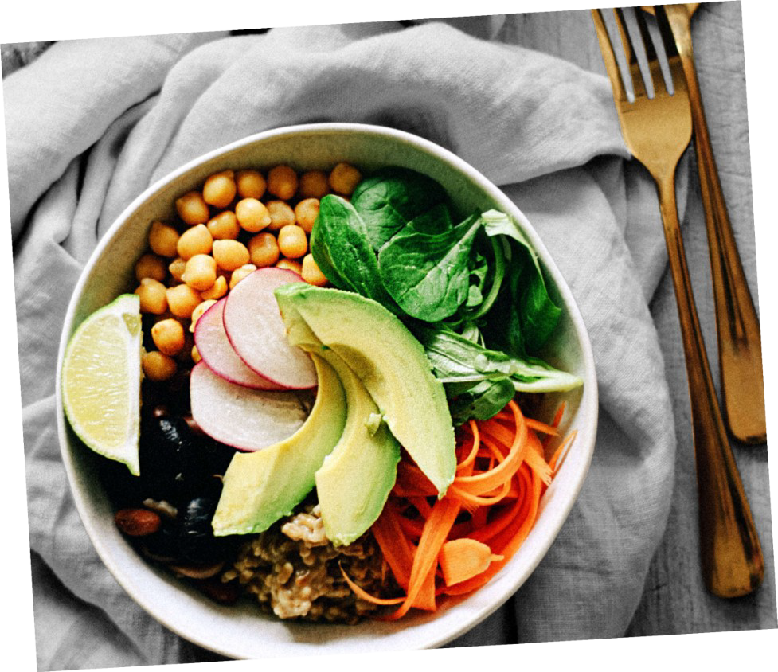
Setup per day
Morning/early afternoon:
■
–
Lectures of ~45-60 minutes, interspersed with (2) short practical(s).
Rest of the day:
■
–
Somewhat longer afternoon practical
Taken together:
■
Lecture (09:00-09:45)
Short practical 1 (09:45-10:45)
Lecture (10:45-11:30)
Short practical 2 (11:30-12:30)
Lecture (13:15-14:00)
Afternoon practical (14:00-17:00)
–
–
–
–
Lunch somewhere here
–
(12:30-13:15 is the idea)
Might shift times a bit.
–

Slide 11


I need your help
This is a new course. So probably, you’ll encounter difficulty spikes, things that don’t make sense,
or other things that are lacklustre.
At the end of each practical I ask you to anonymously rate it and give comments.
In this way, I can hopefully take things on board quickly and perhaps change practicals or lectures during the course, rather than only after!
■
■
■

Slide 12
I need your help
This is a new course. So probably, you’ll encounter difficulty spikes, things that don’t make sense,
or other things that are lacklustre.
This also means that we are going to discover together how much is reasonable to do:
if there’s far too much material, say so, and we can scrap some!
■
■

Slide 13
Warning: difficulty ahead
■
Last years: day 3 (neural networks) is very difficult, so we skip implementing clustering yourself on day 4 because there simply isn’t enough time.
■

Slide 14
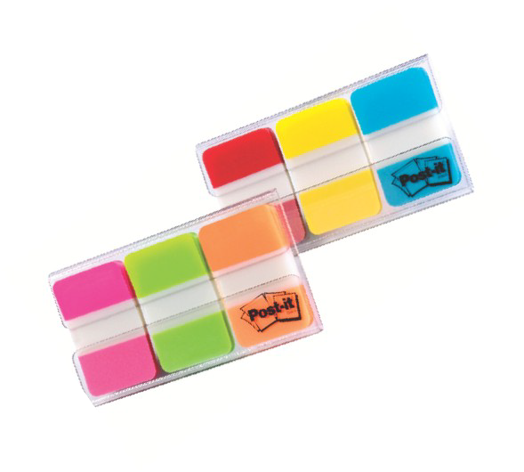
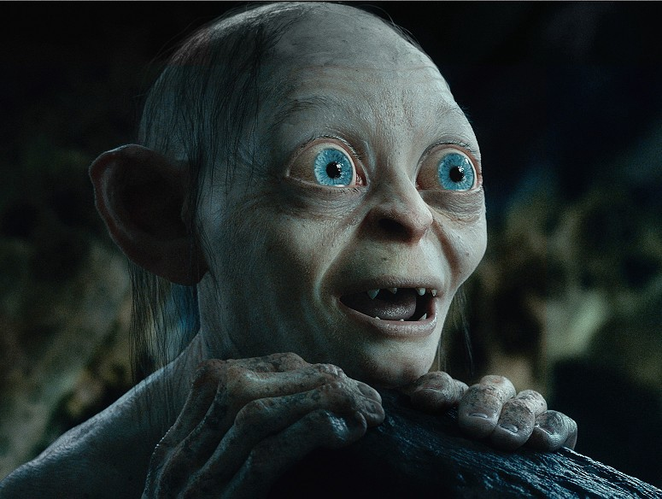
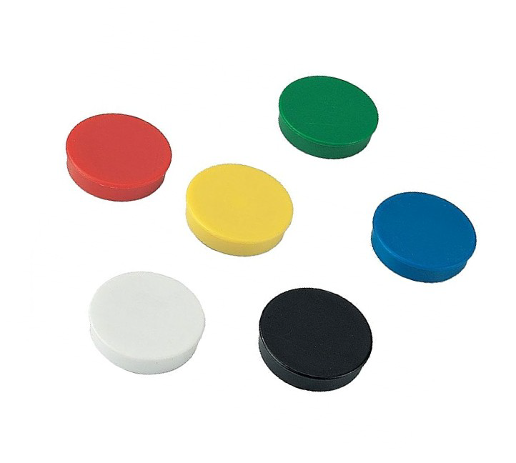
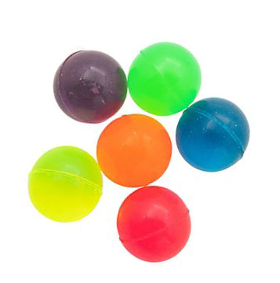
I need your help 2
You might wonder what’s up with the coloured baubles I blessed you with.
■

Slide 15
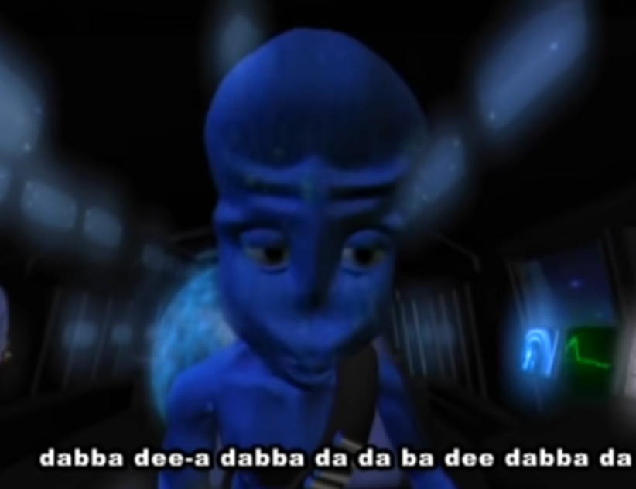
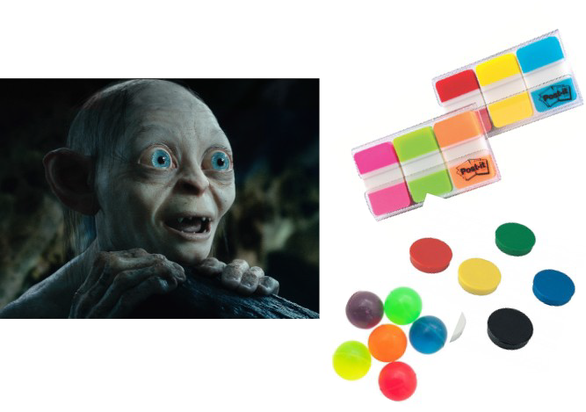



I need your help 2
You might wonder what’s up with the coloured baubles I blessed you with.
They’re mood indicators for during the lecture:
■
■
–
Green: „I am positively brimming with enthusiasm to learn“ and/or „I can follow this material well enough“
Yellow/Orange: „This is somewhat difficult“ and/or „I feel my attention is slipping and I can’t absorb the information so well anymore“
Red: „MAKE IT STOP! PLEASE, PLEASE MAKE IT STOP!!!“
–
–

Slide 16
I need your help 2
Put the bauble that matches your mood at the front of your table.
I tend to make lectures a bit too long. In this way, I can notice that’s happening and stop/address it, without you having to tell me to shut up. Win-win!
■
■

Slide 17
I need your help 2
Please fill out the surveys after the lectures and practicals, I need them to become a certified lean, mean, teaching machine (learning machine)
■

Slide 18
Questions
Besides this, feel free to raise your hand and ask questions when something is unclear.
■
If there’s no hands raised right now then we’ll dive right in!
■

Slide 19
Aha, I can ask you questions
What is ML?
What is deep learning?
What is the goal of ML?
What is a ChatGPT and how does it work?
What is dimension reduction?

Slide 20
This presentation
Two branches of ML: supervised and unsupervised Terminology
Linear regression & cost function Gradient descent & partial derivatives
■
■
■
■

Slide 21

The ugly truth about ML
80% of your time

Slide 22

Map of Machine Learning

Slide 23

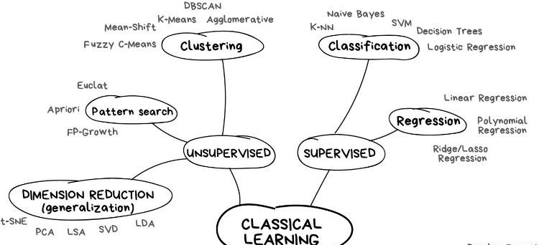
Map of Machine Learning

Slide 24
Map of Machine Learning

Slide 25
Map of Machine Learning

Slide 26
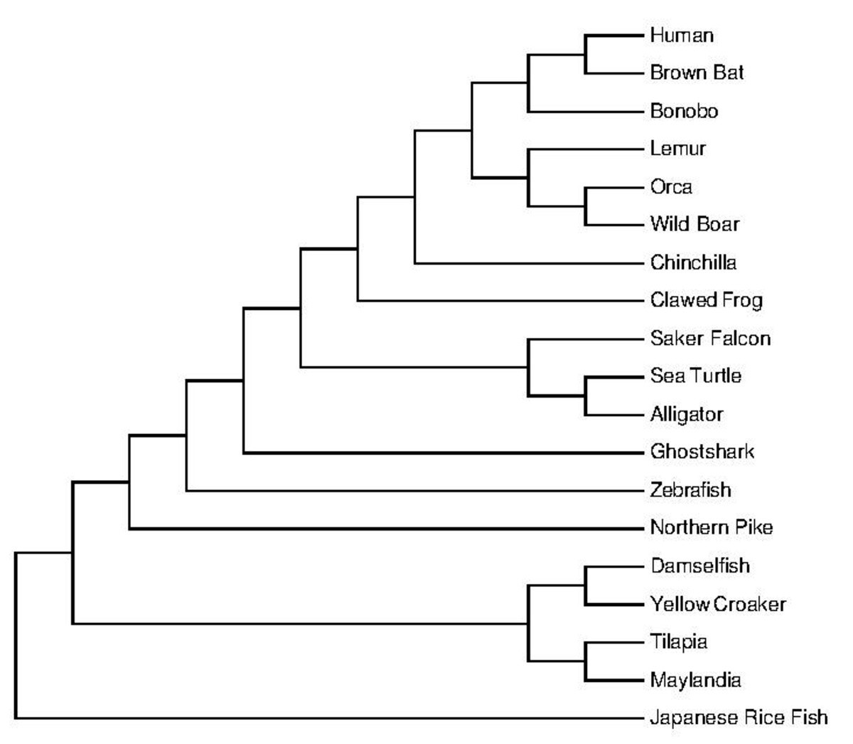
Unsupervised learning: clustering
Automatically find some structure in the data.
■

Slide 27
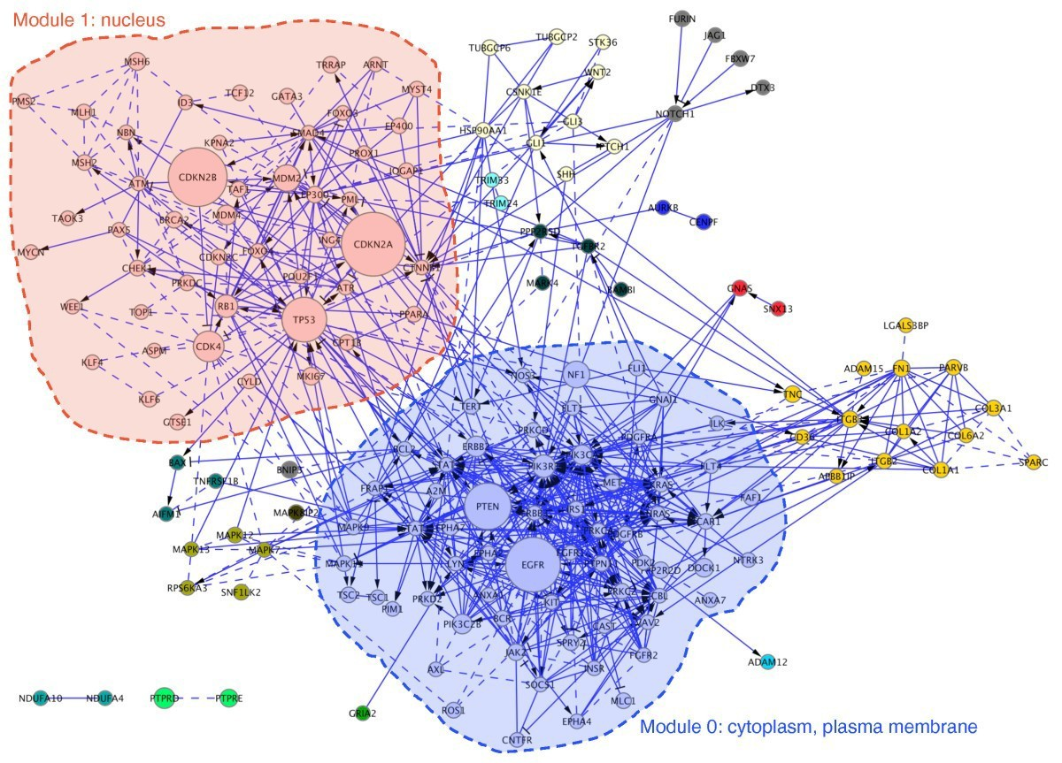
Unsupervised learning: clustering
Automatically find some structure in the data.
■

Slide 28
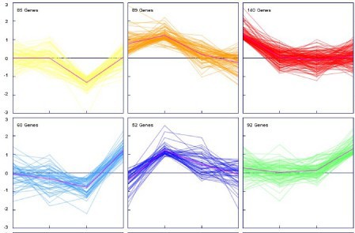
Unsupervised learning: clustering
Automatically find some structure in the data.
■

Slide 29
Unsupervised learning: clustering
No right or wrong:
■
–
Back-and-forth between different clustering algorithms, your knowledge, and the data.
You don‘t know correct clustering.
–

Slide 30
Map of machine learning

Slide 31
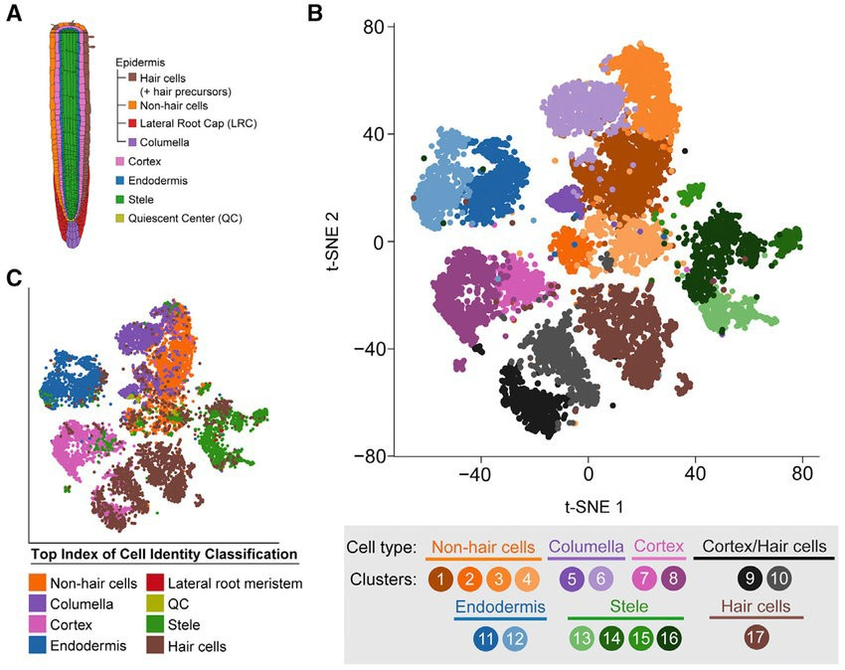
Unsupervised learning: dimensionality reduction
Single-cell RNAseq of
12,198 Arabidopsis root cells.
How do they differ?
■
■

Slide 32
Unsupervised learning: dimensionality reduction
Single-cell RNAseq of
12,198 Arabidopsis root cells.
How do they differ? Visualise differences in all
RNAs between all these cells in 2 dimensions.
Used in conjunction with clustering (colours)
■
■
■
■

Slide 33
Unsupervised learning: dimensionality reduction
Used for:
■
Visualisation (our visual systems cannot deal with > 3D)
Compressing data (capture 90% of the variation with much less data, say)
Preventing overfitting and other ill effects of high dimensionality
–
–
–

Slide 34
Map of Machine Learning

Slide 35
Supervised learning
Given known examples, automatically find a function to map new examples.
■

Slide 36
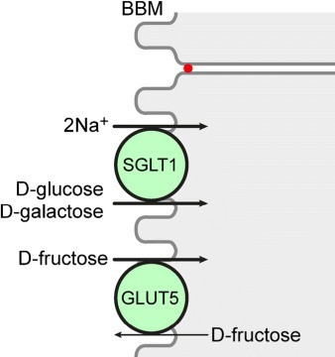
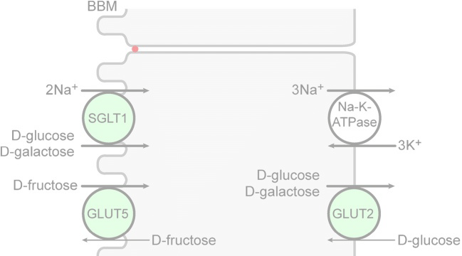
Supervised learning: regression
Given known examples, automatically find a function to map new examples.
Real-valued outputs.
■
■

Slide 37
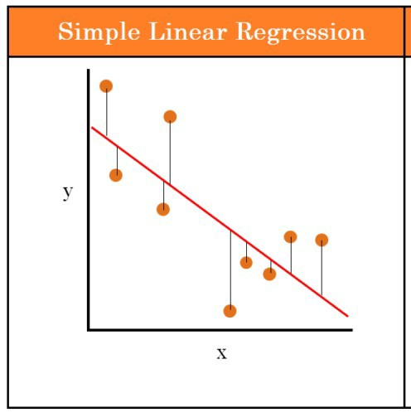
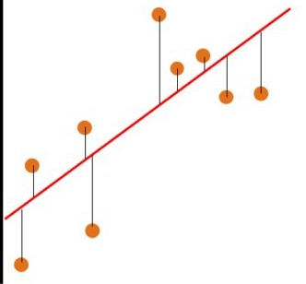
Supervised learning: regression
Given known examples, automatically find a function to map new examples.
Real-valued outputs.
■
■
Blood glucose level
SGLT1 expression

Slide 38
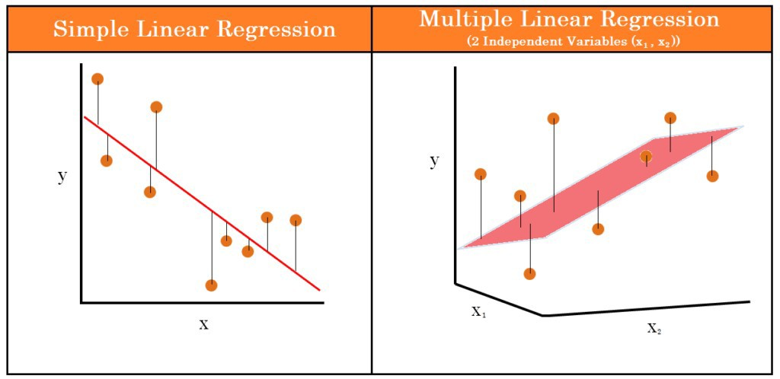
Supervised learning: regression
Given known examples, automatically find a function to map new examples.
Real-valued outputs.
■
■
Blood glucose level
Blood glucose level
SGLT1 expression
SGLT1
GLUT5

Slide 39
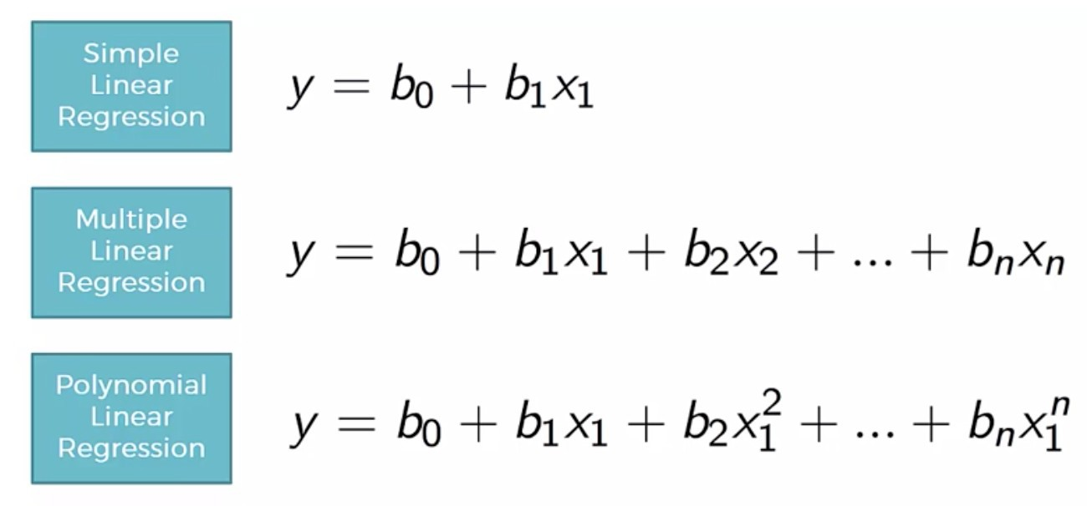
Supervised learning: regression
Given known examples, automatically find a function to map new examples.
Real-valued outputs: regression.
■
■

Slide 40
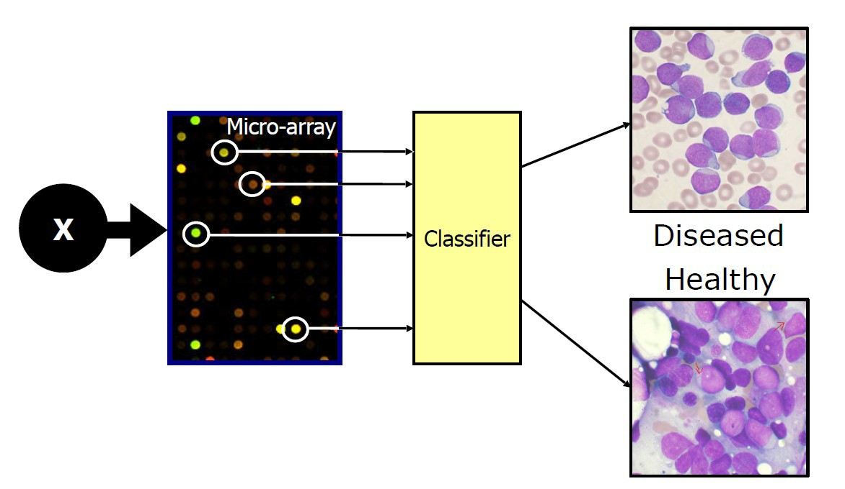
Supervised learning: classification
Given known examples, automatically find a function to map new examples.
Discrete outputs.
■
■
Source: Jeroen de Ridder

Slide 41
Supervised learning: classification
Given known examples, automatically find a function to map new examples.
■
Discrete outputs.
■
Healthy Diseased
Gene 2 expression →
Gene 1 expression →

Slide 42
Supervised learning: classification
Given known examples, automatically find a function to map new examples.
■
Discrete outputs.
■
Healthy Diseased
Gene 2 expression →
?
Gene 1 expression →

Slide 43
Supervised learning: classification
Given known examples, automatically find a function to map new examples.
Discrete outputs.
■
Learned decision boundary
■
Healthy Diseased
Gene 2 expression →
Gene 1 expression →

Slide 44
Supervised learning: classification
Given known examples, automatically find a function to map new examples.
Discrete outputs.
■
Predict diseased
■
Healthy Diseased
Gene 2 expression →
Gene 1 expression →

Slide 45
Map of Machine Learning

Slide 46
Summary
Unsupervised:
■
–
Find some structure in your data (clusters, projection into lower- dimensional space that captures much of variance)
Don‘t know the „correct“ structure (no labels)
–
Supervised:
■
–
Automatically learn a function that maps features (e.g. gene expression) to a real-valued output (regression, e.g. blood glucose level) or discrete classes/labels (classification, e.g. healthy/diseased) using training data for which you know these outcomes.

Slide 47
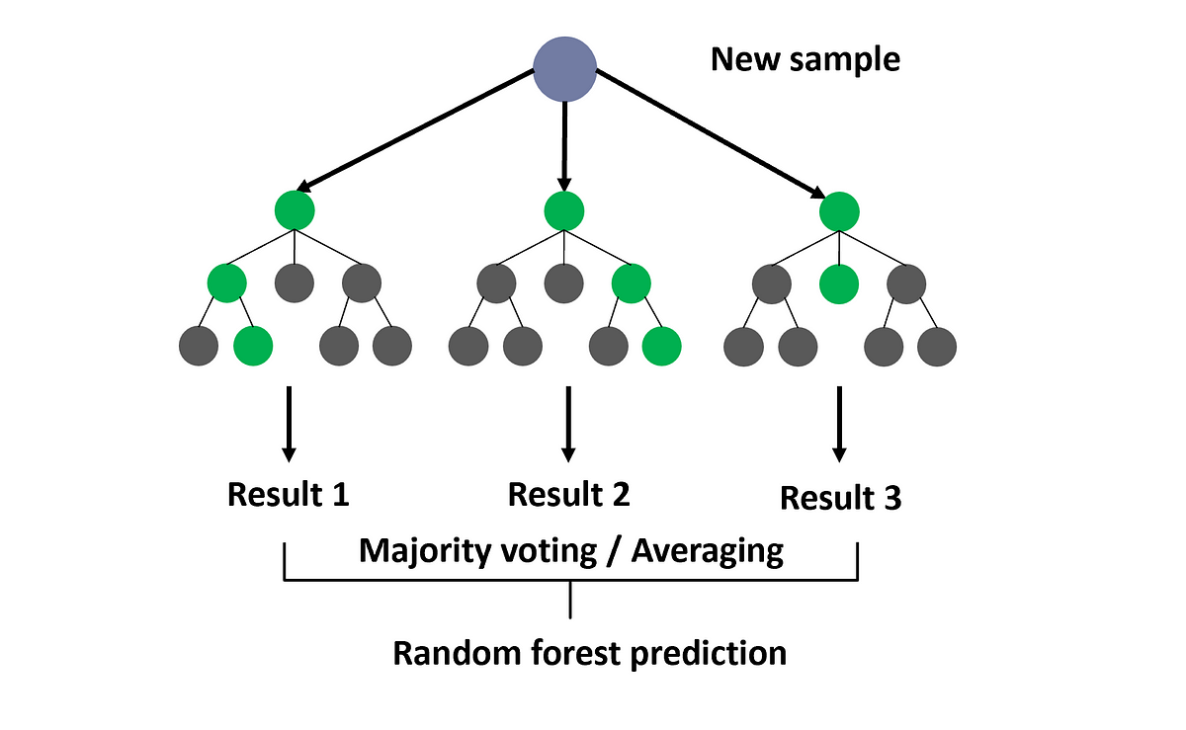
Regression or classification?

Slide 48
Linear regression

Slide 49
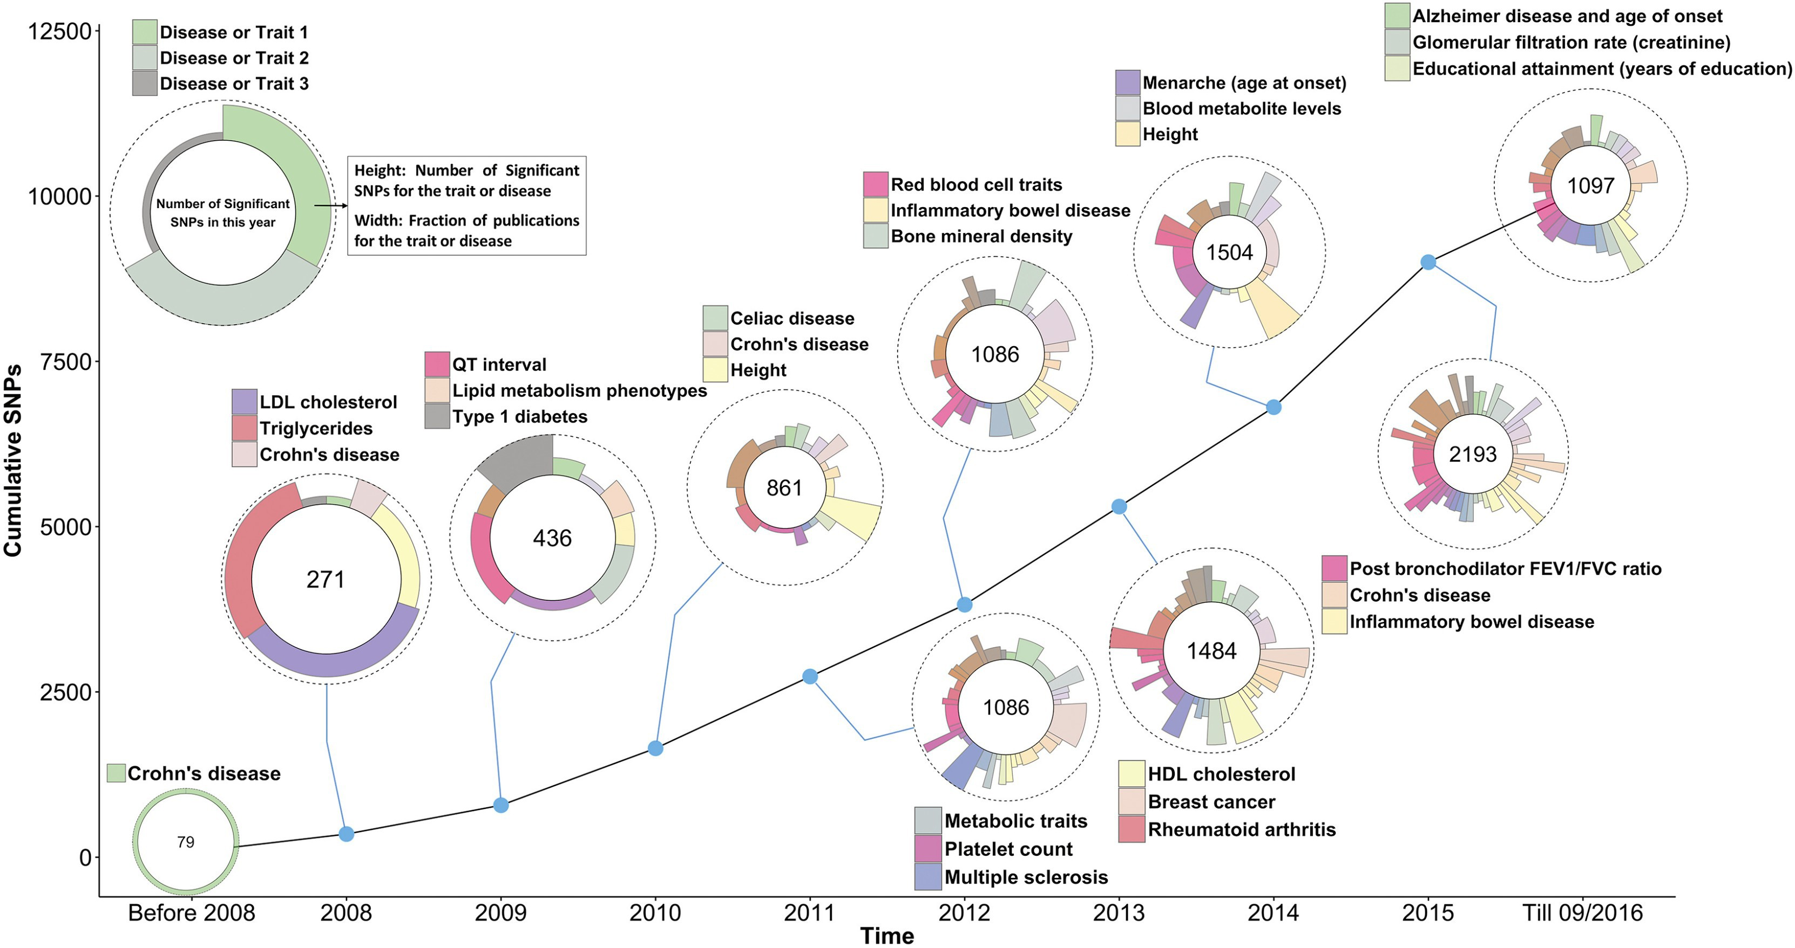
Linear regression: GWAS

Slide 50
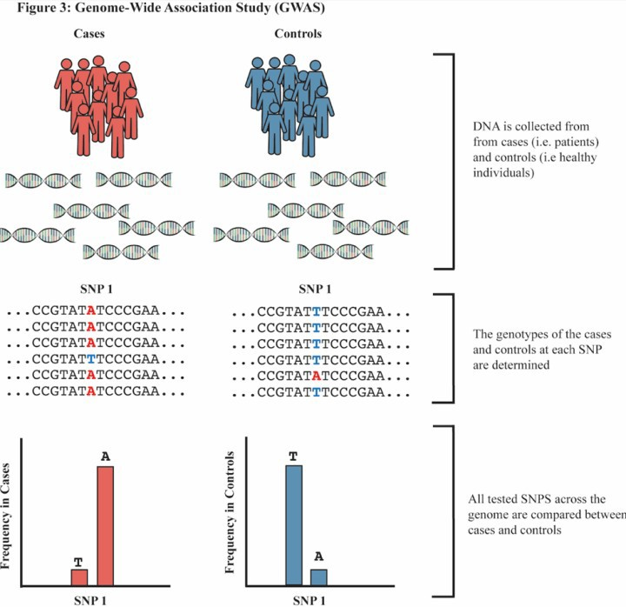
Linear regression: GWAS

Slide 51
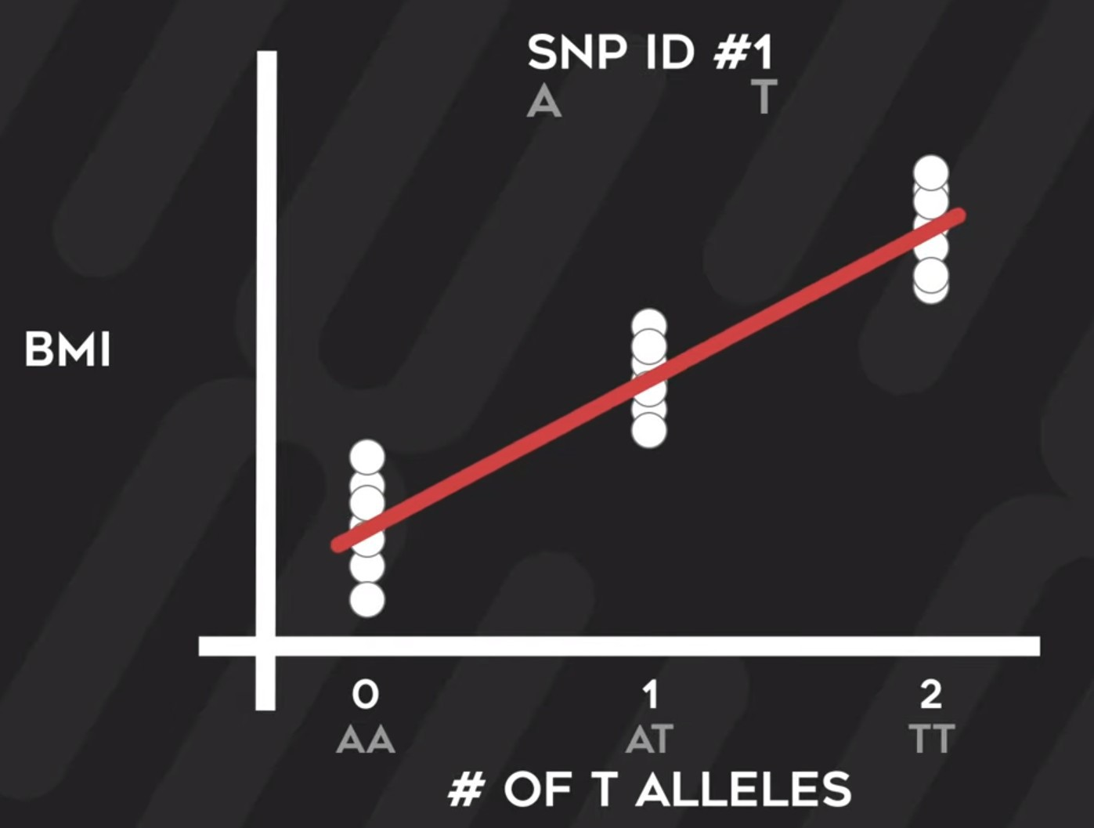
Linear regression: GWAS

Slide 52
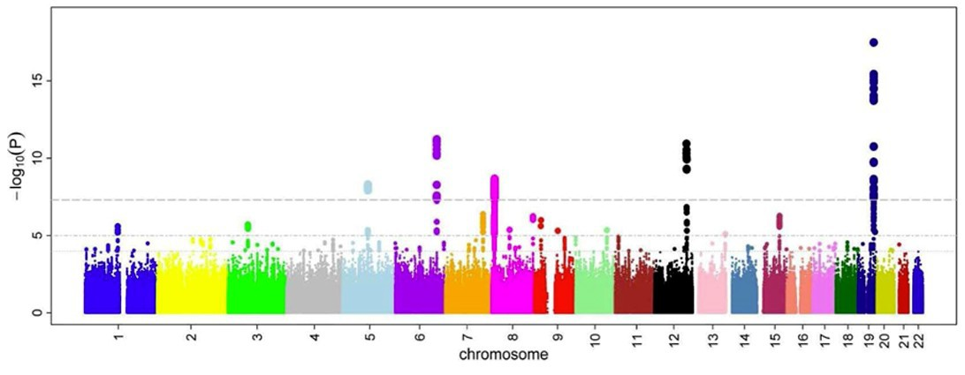
Linear regression: GWAS

Slide 53
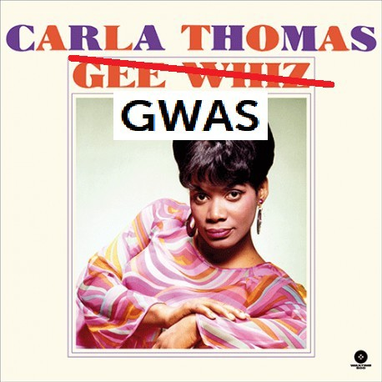
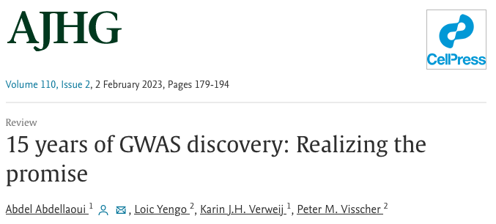
Linear regression: GWAS
Connect SNPs to nearby genes (non-trivial!)
Yielded huge advances in our knowledge on many complex diseases over the past ~15 years.
■
■

Slide 54
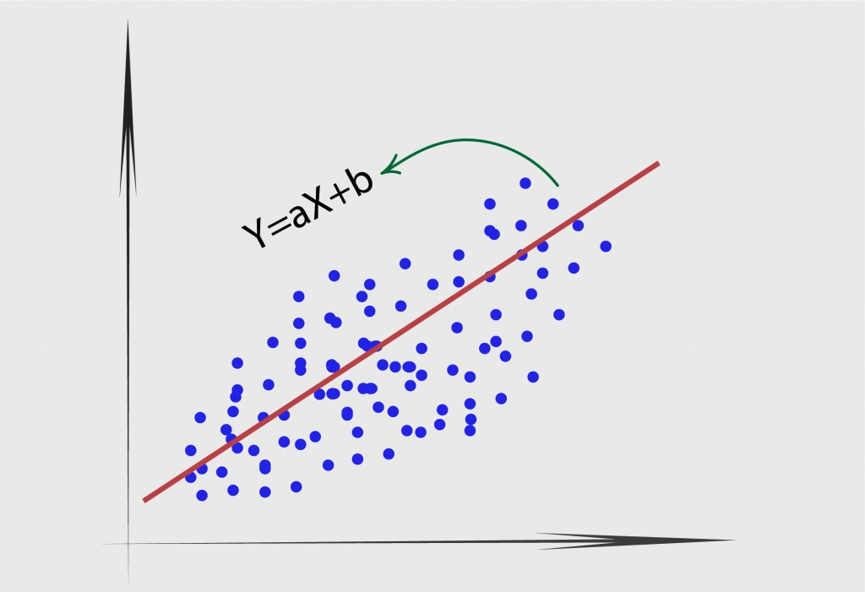
Univariate linear regression
y=ax +b
y=ax +b

Slide 55
Univariate linear regression
y=ax +b
y=ax +b
y=θ ₀ +θ ₁ x

Slide 56
Process
y=ax +b
Training data
Learning algorithm
x of new example
Hypothesis maps x to y
Estimated y ( ^y )
Source: Andrew Ng, Coursera
h_{θ} ( x)=θ ₀+θ ₁ x

Slide 57
Terminology alert! #StatQuest BAM
y=ax +b
Training data
Sample # | SGLT1 expression level (arbitrary units relative to housekeeping gene) | Blood glucose level (mg/dL)
1 | 3 | 80
2 | 8 | 130
3 | 12 | 170
4 | 2 | 89

Slide 58
Terminology
y=ax +b
Training data
Sample # | SGLT1 expression level (arbitrary units relative to housekeeping gene) | Blood glucose level (mg/dL)
1 | 3 | 80
2 | 8 | 130
3 | 12 | 170
4 | 2 | 89
m = # of training examples
m

Slide 59
Terminology
y=ax +b
Training data
Sample # | SGLT1 expression level (arbitrary units relative to housekeeping gene) | Blood glucose level (mg/dL)
1 | 3 | 80
2 | 8 | 130
3 | 12 | 170
4 | 2 | 89
m = # of training examples
n = # of features/variables
m
n

Slide 60
Terminology
y=ax +b
Training data
Sample # | x1 | x2 | x3 | Blood glucose level (mg/dL)
1 | 3 | 2 | 11 | 80
2 | 8 | 3 | 2 | 130
3 | 12 | 4 | 666 | 170
4 | 2 | 6 | 5 | 89
m
m = # of training examples
n = # of features/variables
n

Slide 61
Terminology
y=ax +b
Training data
Sample # | SGLT1 expression level (arbitrary units relative to housekeeping gene) | Blood glucose level (mg/dL)
1 | 3 | 80
2 | 8 | 130
3 | 12 | 170
4 | 2 | 89
m = # of training examples
n = # of features/variables y = output variable/target variable or label (classification)
m
n
y

Slide 62
Terminology
y=ax +b
Training data
Sample #
SGLT1 expression level (arbitrary units relative to housekeeping gene)
Blood glucose level (mg/dL)
1
3
80
2
8
130
m = # of training examples
n = # of features/variables y = output variable/target variable or label (classification)
(x^{(i)}, y^{(i)}) = i-th training example
m
3
12
170
4
2
89
_{(x}(3)_{, y}(3)₎
n
y

Slide 63
Cost function and gradient descent
How to learn theta‘s from data? Two parts
y=ax +b
■
■
How wrong are we for given parameters?
How do we update our parameters, given how wrong we are?
–
–
h_{θ} ( x)=θ ₀+θ ₁ x

Slide 64
Cost function and gradient descent
How to learn theta‘s from data? Two parts
y=ax +b
■
■
How wrong are we for given parameters?
How do we update our parameters, given how wrong we are?
–
–
h_{θ} ( x)=θ ₀+θ ₁ x

Slide 65
Cost function
y=ax +b
How wrong are we for given parameters?
h_{θ} ( x)=θ ₀+θ ₁ x
■
250
f(x) = 9.06 x + 47.29
200
Blood glucose level
150
100
50
0
0
2
4
6
8 10
SGLT1 expression
12
14
16
18

Slide 66
Cost function
How wrong are we for given parameters? Cost function:
m
h_{θ} ( x)=θ ₀+θ ₁ x
y=ax +b
■
250
■
f(x) = 9.06 x + 47.29
200
Blood glucose level
1
m
∑ (h_{θ} ( x )− y )
i
150
100
50
0
J (θ ₀ ,θ ₁)=
(i) (i) 2
0
2
4
6 8 10 12 14 16 18
SGLT1 expression

Slide 67
Cost function
How wrong are we for given parameters? Cost function:
m
h_{θ} ( x)=θ ₀+θ ₁ x
y=ax +b
■
250
■
f(x) = 9.06 x + 47.29
200
Blood glucose level
1
m
∑ (h_{θ} ( x )− y )
150
100
50
0
J (θ ₀ ,θ ₁)=
(i) (i) 2
i
6 8 10 12 14 16 18
SGLT1 expression
0
2
4
1 2 m
m
∑
i
_{(x}(i)_{)− y}(i)₎2
J (θ ₀ ,θ ₁)=
(h
θ
Notes:
Make sure to say here that dividing the cost function or multiplying it doesn’t matter.

Slide 68
Cost function
How wrong are we for given parameters? Cost function:
m
h_{θ} ( x)=θ ₀+θ ₁ x
y=ax +b
■
250
■
f(x) = 9.06 x + 47.29
200
Blood glucose level
1
m
∑ (h_{θ} ( x )− y )
150
100
50
0
J (θ ₀ ,θ ₁)=
(i) (i) 2
i
6 8 10 12 14 16 18
SGLT1 expression
0
2
4
1 2 m
1 2 m
m
∑
i
m
∑
i
J (θ ₀ ,θ ₁)=
(i) (i) 2
(h (x )− y )
θ
J (θ ₀ ,θ ₁)=
(θ +θ ⋅
(i) (i) 2
x − y )
0 1

Slide 69

Cost function
How wrong are we for given parameters? Cost function:
h_{θ} ( x)=θ ₀+θ ₁ x
y=ax +b
■
■
1
m
m
∑
250
J (θ ₀ ,θ ₁)=
(i) (i) 2
f(x) = 9.06 x + 47.29
(h ( x )− y )
θ
200
i=1
Blood glucose level
150
1 2 m
1
m
∑
i=1
m
_{( x}(i)_{)− y}(i)₎2
100
J (θ ₀ ,θ ₁)=
(h
θ
50
0
0
2
4
6
8 10
SGLT1 expression
12
14
16
18
J (θ ₀ ,θ ₁)=
∑
(θ +θ ⋅
(i) (i) 2
x − y )
2 m _{i}
0 1
=1

Slide 70
Cost function conclusion
y=ax +b
If we want to be as correct as possible with our prediction,
■
want to minimise:
1
m
∑
J (θ ,θ )=
(θ +θ ⋅
(i) (i) 2
x − y )
0 1
2 m _{i}
0 1
=1

Slide 71
Cost function conclusion
y=ax +b
If we want to be as correct as possible with our prediction,
■
want to minimise:
1
m
∑
J (θ ,θ )=
(θ +θ ⋅
(i) (i) 2
x − y )
0 1
2 m _{i}
0 1
=1
Simplified example: Theta_0 = 0:
■
1
m
∑
J (θ )=
(i) (i) 2
(θ ⋅x − y )
1
2 m _{i}
1
=1

Slide 72
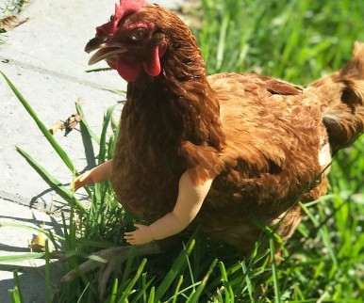
Cost function conclusion illustration
y=ax +b
Let‘s say theta0 = 0 (so the intercept is 0). What is J(theta1)
■
for different values of theta1?
4
3
clucks/minute
2
1
0
0
1
2
Amount of chickens in barn
3
4

Slide 73
Cost function illustration
y=ax +b
Let‘s say theta0 = 0 (so the intercept is 0). What is J(theta1)
■
for different values of theta1? Theta1 = 1
4
4
■
3
1
3
∑
J (θ )=
(i) (i) 2
clucks/minute
(θ ⋅x − y )
2
1
2 m _{i}
1
=1
1
J (θ ₁)=0
0
0
0
1
2
Amount of chickens in barn
3
4

Slide 74
Cost function illustration
4
10
9
8
7
6
5
4
3
2
1
0
3
clucks/minute
2
J(θ1)
1
0
0
1
2
Amount of chickens in barn
3
4
0
1
2
3
θ1

Slide 75
Cost function illustration
y=ax +b
Let‘s say theta0 = 0 (so the intercept is 0). What is J(theta1)
■
for different values of theta1? Theta1 = 3
4
■
3
1
3
∑
J (θ )=
(i) (i) 2
clucks/minute
(θ ⋅x − y )
1
2 m _{i}
1
2
=1
1
0
0
1
2
Amount of chickens in barn
3
4
1
J (θ )=
2 2 2
⋅((3−1) +(6−2) +(9−3) )=56 / 6≈9.3
1
2⋅3

Slide 76
Cost function illustration
4
10
9
8
7
6
5
4
3
2
1
0
3
clucks/minute
2
J(θ1)
1
0
0
1
2
Amount of chickens in barn
3
4
0
1
2
3
θ1

Slide 77
Cost function illustration
y=ax +b
Let‘s say theta0 = 0 (so the intercept is 0). What is J(theta1)
■
for different values of theta1? Theta1 = 0.5
4
■
3
1
3
∑
J (θ )=
(i) (i) 2
clucks/minute
(θ ⋅x − y )
2
1
2 m _{i}
1
=1
1
0
0
1
2
Amount of chickens in barn
3
4
1
J (θ )=
2 2 2
⋅((0.5−1) +(1−2) +(1.5−3) )=3.5 /6≈0.6
1
2⋅3

Slide 78
Cost function illustration
10
9
8
7
6
5
4
3
2
1
0
J(θ1)
-2
-1
0
1
2
3
4
5
θ1

Slide 79

Cost function and gradient descent
How to learn theta‘s from data? Two parts
y=ax +b
■
■
How wrong are we for given parameters?
How do we update our parameters, given how wrong we are?
–
–

Slide 80

Gradient descent
Want to minimise Where to go?
■
10
■
9
8
7
6
5
4
3
2
1
0
J(θ1)
-2
-1
0
1
2
3
4
5
θ1

Slide 81
Gradient descent
Want to minimise Where to go?
■
10
■
9
8
7
6
J(θ1)
5
Δy
4
3
2
1
0
-2
-1
0
1
2
Δx
3
4
5
θ1

Slide 82
Gradient descent
Want to minimise Where to go?
■
10
■
9
8
7
6
J(θ1)
5
Δy
4
Δy/Δx =
3
10/2 =
2
5
1
0
Δx
-2
-1
0
1
2
3
4
5
θ1

Slide 83

Gradient descent
Want to minimise Where to go?
■
10
■
9
8
7
6
J(θ1)
Δy
5
4
Δy/Δx =
3
-10/2 =
2
-5
1
-1_{Δx}
0
-2
0
1
2
3
4
5
θ1

Slide 84
Gradient descent
Want to minimise Where to go?
Change current theta1 as follows:
d
■
10
■
9
8
■
7
6
J(θ1)
Δy
5
4
Δy/Δx =
θ ₁=θ ₁−α⋅
J (θ ₁)
3
-10/2 =
dθ ₁
2
-5
1
-1_{Δx}
0
-2
0
1
2
3
4
5
θ1

Slide 85
Gradient descent
Want to minimise Where to go?
Change current theta1 as follows:
d
■
10
■
9
8
■
7
6
J(θ1)
Δy
5
4
Δy/Δx =
θ ₁=θ ₁−α⋅
α =0.1
J (θ ₁)
3
-10/2 =
dθ ₁
2
-5
1
-1_{Δx}
0
0
-2
1
2
3
4
5
θ ₁=0−0.1⋅−5
θ ₁=0.5
θ1

Slide 86

Gradient descent
Want to minimise Where to go?
Change current theta1 as follows:
d
■
10
■
9
8
■
7
6
J(θ1)
Δy
5
4
Δy/Δx =
θ ₁=θ ₁−α⋅
α =0.1
J (θ ₁)
3
-10/2 =
dθ ₁
2
1
-5
-1_{Δx}
0
0
-2
1
2
3
4
5
θ ₁=0−0.1⋅−5
θ ₁=0.5
θ1

Slide 87
Gradient descent
Want to minimise Where to go?
Change current theta1
Note: gradient becomes smaller closer to optimum, so can use fixed value for α
■
10
■
9
8
■
7
6
J(θ1)
Δy
5
■
4
3
2
1
-1_{Δx}
0
-2
0
1
2
3
4
5
θ1

Slide 88


Gradient descent
Want to minimise Where to go?
Change current theta1
Note: gradient becomes smaller closer to optimum, so can use fixed value for α
■
10
■
9
8
■
7
6
J(θ1)
Δy
5
■
4
3
2
1
-1_{Δx}
0
-2
0
1
2
3
4
5
θ1

Slide 89

Gradient descent
Works also from other direction.
■
10
9
8
θ =θ −α⋅ ^{d} J (θ )
7
1 1
dθ
1
6
α =0.2
1
J(θ1)
5
Δy
4
Δy/Δx =
θ ₁=2−0.2⋅5
θ ₁=1
3
10/2 =
2
5
1
0
0
Δx
-2
-1
1
2
3
4
5
θ1

Slide 90
Gradient descent
Iteratively descend down the gradient of the cost function until convergence → optimal parameters!
■

Slide 91
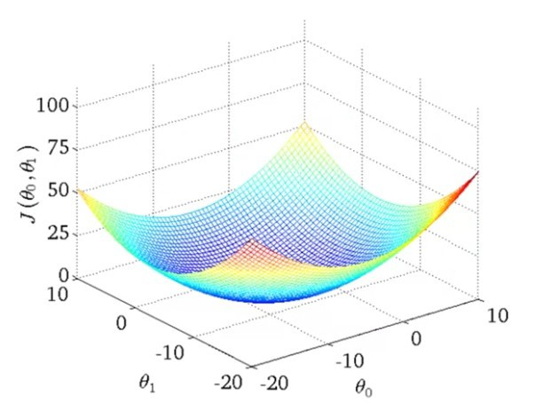
Gradient descent
Iteratively descend down the gradient of the cost function until convergence → optimal parameters!
In reality: not one-dimensional:
■
■
Source: Andrew Ng, Coursera

Slide 92

Gradient descent: partial derivatives
Iteratively descend down the gradient of the cost function until convergence → optimal parameters!
In reality: not one-dimensional. Want to fit intercept and slope.
Use partial derivatives instead:
■
■
■
Source: Andrew Ng, Coursera

Slide 93
Gradient descent: partial derivatives
Iteratively descend down the gradient of the cost function until convergence → optimal parameters!
In reality: not one-dimensional.
■
■
Want to fit intercept and slope. Use partial derivatives instead:
Direction theta0 change
■
Source: Andrew Ng, Coursera

Slide 94

Gradient descent: partial derivatives
Iteratively descend down the gradient of the cost function until convergence → optimal parameters!
■
In reality: not one-dimensional. Want to fit intercept and slope.
Use partial derivatives instead:
■
Direction theta1 change
■
Source: Andrew Ng, Coursera

Slide 95

Gradient descent: partial derivatives
Iteratively descend down the gradient of the cost function until convergence → optimal parameters!
■
In reality: not one-dimensional. Want to fit intercept and slope.
Use partial derivatives instead:
■
Combined step
■
Source: Andrew Ng, Coursera

Slide 96
Gradient descent: partial derivatives
Main idea:
Act like your function depends on only 1 parameter and treat the rest as constants (just numbers), then take the derivative. Do that for every parameter!
Source: Andrew Ng, Coursera

Slide 97
Gradient descent: partial derivatives
Partial derivatives:
■
1
m
∑
J (θ ₀ ,θ ₁)=
(θ +θ ⋅
(i) (i) 2
x − y )
2 m _{i}
0 1
=1
Source: Andrew Ng, Coursera

Slide 98
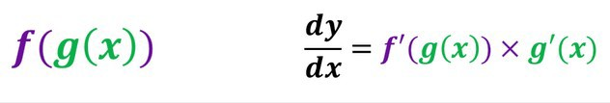
Gradient descent: partial derivatives
4
Partial derivatives:
3
■
clucks/minute
1 2 m
m
∑
i=1
2
J (θ ,θ )=
(θ +θ
(i) (i) 2
1
⋅x − y )
0 1
m=2
0
1
0
0
1 2 3
Amount of chickens in barn
4
1 2⋅2
Source: Andrew Ng, Coursera
J (θ ₀ ,θ ₁)=
((θ +θ ⋅
(1) (1) 2
(2) (2) 2
x − y ) +(θ +θ ⋅
x − y ) )
0 1
0 1
Notes:
Gonna need the chain rule here.

Slide 99


Gradient descent: partial derivatives
Partial derivatives:
■
J (θ ₀ ,θ ₁)=
m=2
1
m
∑
(θ +θ ⋅
(i) (i) 2
x − y )
2 m _{i}
0 1
=1
1 2⋅2
Source: Andrew Ng, Coursera
J (θ ₀ ,θ ₁)=
(1)
(1) 2
(2)
(2) 2
((θ +θ ⋅x − y ) +(θ +θ ⋅
x − y ) )
0 1
0 1
$$x^{2}$$
$$z^{2}$$
Notes:
This is like x^2. The whole thing is squared. Note that it looks intense but they’re all just numbers: parameters + feature value + label (y)

Slide 100


Gradient descent: partial derivatives
Partial derivatives:
■
J (θ ₀ ,θ ₁)=
m=2
1
m
∑
(θ +θ ⋅
(i) (i) 2
x − y )
2 m _{i}
0 1
=1
1 2⋅2
Source: Andrew Ng, Coursera
J (θ ₀ ,θ ₁)=
(1)
(1) 2
(2)
(2) 2
((θ +θ ⋅x − y ) +(θ +θ ⋅
x − y ) )
0 1
0 1
$$x^{2}$$
$$z^{2}$$
$${2x}^{}$$
$${2z}^{}$$
Notes:
This is like x^2. The whole thing is squared. Note that it looks intense but they’re all just numbers: parameters + feature value + label (y)

Slide 101
Gradient descent: partial derivatives
Partial derivatives:
■
J (θ ₀ ,θ ₁)=
m=2
1
m
∑
(θ +θ ⋅
(i) (i) 2
x − y )
2 m _{i}
0 1
=1
1
Source: Andrew Ng, Coursera
J (θ ₀ ,θ ₁)=
((θ +θ ⋅
(1)
(1) 2
(2)
(2) 2
x − y ) +(θ +θ ⋅
x − y ) )
2⋅2
0 1
0 1
1 2⋅2
∂ J (θ ,θ )=
( 2(θ +θ ⋅
(1) (1)
x − y )∗1
∂θ ₀
0 1
0 1
+2(θ +θ ⋅
(2) (2)
x − y )∗1)
0 1
Notes:
Remember, only with respect to theta0! So theta0 = x, the rest are all just numbers!

Slide 102
Gradient descent: partial derivatives
Partial derivatives:
■
J (θ ₀ ,θ ₁)=
m=2
1
m
∑
(θ +θ ⋅
(i) (i) 2
x − y )
2 m _{i}
0 1
=1
1
Source: Andrew Ng, Coursera
J (θ ₀ ,θ ₁)=
((θ +θ ⋅
(1)
(1) 2
(2)
(2) 2
x − y ) +(θ +θ ⋅
x − y ) )
2⋅2
0 1
0 1
1 2⋅2
∂ J (θ ,θ )=
( 2(θ +θ ⋅
(1) (1)
x − y )∗1
∂θ ₀
0 1
0 1
+2(θ +θ ⋅
(2) (2)
x − y )∗1)
0 1
Notes:
Hier doen we partial derivative met respect tot theta_0. Betekent: doet alsof alles constant

Slide 103
Gradient descent: partial derivatives
Partial derivatives:
■
J (θ ₀ ,θ ₁)=
m=2
1
m
∑
(θ +θ ⋅
(i) (i) 2
x − y )
2 m _{i}
0 1
=1
1 2⋅2
Source: Andrew Ng, Coursera
J (θ ₀ ,θ ₁)=
((θ +θ ⋅
(1)
(1) 2
(2)
(2) 2
x − y ) +(θ +θ ⋅
x − y ) )
0 1
0 1
∂
(1)
(1)
g ' ( x)=
( 1⋅θ +θ ⋅x − y
)=1
∂θ ₀
0 1
Notes:
This is 1*x → 1, x^0 = 1.

Slide 104
Gradient descent: partial derivatives
Partial derivatives:
■
J (θ ₀ ,θ ₁)=
m=2
1
m
∑
(θ +θ ⋅
(i) (i) 2
x − y )
2 m _{i}
0 1
=1
1
Source: Andrew Ng, Coursera
J (θ ₀ ,θ ₁)=
(1)
(1) 2
(2)
(2) 2
((θ +θ ⋅x − y ) +(θ +θ ⋅
x − y ) )
2⋅2
0 1
0 1
f ' ( g( x))= ∂ ( g (x))²=2⋅g (x)
∂θ ₀

Slide 105
Gradient descent: partial derivatives
Partial derivatives:
■
J (θ ₀ ,θ ₁)=
m=2
1
m
∑
(θ +θ ⋅
(i) (i) 2
x − y )
2 m _{i}
0 1
=1
1 2⋅2
Source: Andrew Ng, Coursera
∂ J (θ ,θ )=
( 2(θ +θ ⋅
(1) (1)
x − y )∗1
∂θ ₀
0 1
0 1
+2(θ +θ ⋅
(2) (2)
x − y )∗1)
0 1

Slide 106
Gradient descent: partial derivatives
Partial derivatives:
■
J (θ ₀ ,θ ₁)=
m=2
1
m
∑
(θ +θ ⋅
(i) (i) 2
x − y )
2 m _{i}
0 1
=1
1 2⋅2
Source: Andrew Ng, Coursera
∂ J (θ ,θ )=
( 2(θ +θ ⋅
(1) (1)
x − y )∗1
∂θ ₀
0 1
0 1
+2(θ +θ ⋅
(2) (2)
x − y )∗1)
0 1

Slide 107
Gradient descent: partial derivatives
Partial derivatives:
■
J (θ ₀ ,θ ₁)=
m=2
1
m
∑
(θ +θ ⋅
(i) (i) 2
x − y )
2 m _{i}
0 1
=1
1 2⋅2
Source: Andrew Ng, Coursera
∂ J (θ ,θ )=
( 2((θ +θ ⋅
(1) (1)
1+(θ +θ ⋅
(2) (2)
x − y )∗
x − y )∗1))
∂θ ₀
0 1
0 1
0 1

Slide 108
Gradient descent: partial derivatives
Partial derivatives:
■
J (θ ₀ ,θ ₁)=
m=2
1
m
∑
(θ +θ ⋅
(i) (i) 2
x − y )
2 m _{i}
0 1
=1
1
Source: Andrew Ng, Coursera
∂ J (θ ,θ )=
( 2((θ +θ ⋅
(1) (1)
1+(θ +θ ⋅
(2) (2)
x − y )∗
x − y )∗1))
∂θ ₀
0 1
2⋅2
0 1
0 1

Slide 109
Gradient descent: partial derivatives
Partial derivatives:
■
J (θ ₀ ,θ ₁)=
m=2
1
m
∑
(θ +θ ⋅
(i) (i) 2
x − y )
2 m _{i}
0 1
=1
1
Source: Andrew Ng, Coursera
∂ J (θ ,θ
θ +θ ⋅
(1) (1)
(2)
(2)
)= ((
x − y )+(θ +θ ⋅
x − y ))
∂θ ₀
0 1
2
0 1
0 1

Slide 110
Gradient descent: partial derivatives
Partial derivatives:
■
J (θ ₀ ,θ ₁)=
m=2
1
m
∑
(θ +θ ⋅
(i) (i) 2
x − y )
2 m _{i}
0 1
=1
1
Source: Andrew Ng, Coursera
∂ J (θ ,θ
θ +θ ⋅
(1) (1)
(2)
(2)
∂θ ₀
∂
∂θ ₀
)= ((
x − y )+(θ +θ ⋅
x − y ))
0 1
2
1
0 1
0 1
m
∑
J (θ ₀ ,θ ₁)=
(θ +θ ⋅
(i) (i)
x − y )
m _{i}
0 1
=1

Slide 111
Gradient descent: partial derivatives
Partial derivatives:
■
J (θ ₀ ,θ ₁)=
m=2
1
m
∑
(θ +θ ⋅
(i) (i) 2
x − y )
2 m _{i}
0 1
=1
1
Source: Andrew Ng, Coursera
∂ J (θ ,θ
θ +θ ⋅
(1) (1)
(2) (2)
∂θ ₀
∂
∂θ ₀
)= ((
x − y )+(θ +θ ⋅
x − y ))
1
m
h_{θ} ( x)=θ ₀+θ ₁ x
0 1
2
1
0 1
0
m
∑
1
m
J (θ ₀ ,θ ₁)=
(θ +θ ⋅
(i) (i)
∑
i=1
(i)
(i)
x − y )=
(h ( x )−
y )
m _{i}
0 1
θ
=1

Slide 112
Gradient descent: partial derivatives
Partial derivatives:
■
J (θ ₀ ,θ ₁)=
m=2
1
m
∑
(θ +θ ⋅
(i) (i) 2
x − y )
2 m _{i}
0 1
=1
1 2⋅2
Source: Andrew Ng, Coursera
J (θ ₀ ,θ ₁)=
((θ +θ ⋅
(1) (1) 2
(2) (2) 2
x − y ) +(θ +θ ⋅
x − y ) )
0
1 2⋅2
1
0 1
∂
∂θ ₁
(1) (1)
(1)
J (θ ₀ ,θ ₁)=
(2(θ +θ ⋅x − y
)∗x
0 1
(2) (2)
(2)
+2(θ +θ ⋅x − y
)∗x )
0 1
(1) (1)
(2(θ +θ ⋅x − y
)
0 1
Notes:
Now only treat theta_1 as a variable → remember that x^1 and y1 are just numbers, so this is just saying: some number * x → derivative relative to x → that number

Slide 113
Gradient descent: partial derivatives
Partial derivative theta1:
■
∂
∂θ ₁
1
m
∑
J (θ ₀ ,θ ₁)=
(i) (i) (i)
((h ( x )− y )⋅
x )
m _{i}
θ
=1
Source: Andrew Ng, Coursera

Slide 114
Cost function and gradient descent
Cost function:
■
1
m
∑
J (θ ,θ )=
(h (x)− y^{(i)})²
0 1
2 m _{i}
θ
=1
Partial derivatives for gradient descent:
■
Source: Andrew Ng, Coursera
∂
∂θ ₀
1
m
∑
_{( x}(i)_{)− y}(i)₎
J (θ ₀ ,θ ₁)=
(h
h_{θ} ( x)=θ ₀+θ ₁ x
m _{i}
θ
=1
m
∂
∂θ ₁
1
∑
J (θ ₀ ,θ ₁)=
(i) (i) (i)
((h ( x )− y )⋅
x )
m _{i}
θ
=1

Slide 115
Cost function and gradient descent
Cost function:
■
1
m
∑
J (θ ₀ ,θ ₁)=
(h (x)− y^{(i)})²
2 m _{i}
θ
=1
Gradient descent update:
■
Source: Andrew Ng, Coursera
∂
α
m
∑
_{(x}(i)_{)− y}(i)₎
θ ₀=θ ₀−α
J (θ ₀ ,θ ₁)=θ ₀−
(h
h_{θ} ( x)=θ ₀+θ ₁ x
∂θ ₀
m _{i}
θ
=1
m
∂
∂θ ₁
α
∑
(i) (i) (i)
θ ₁=θ ₁−α
J (θ ₀ ,θ ₁)=θ ₁−
((h ( x )− y )⋅
x )
m _{i}
θ
=1

Slide 116
What about α?
Learning rate, so-called hyperparameter.
■
Source: Andrew Ng, Coursera
∂
∂θ ₀
α
m
∑
_{(x}(i)_{)− y}(i)₎
θ ₀=θ ₀−α
J (θ ₀ ,θ ₁)=θ ₀−
(h
m _{i}
θ
=1

Slide 117
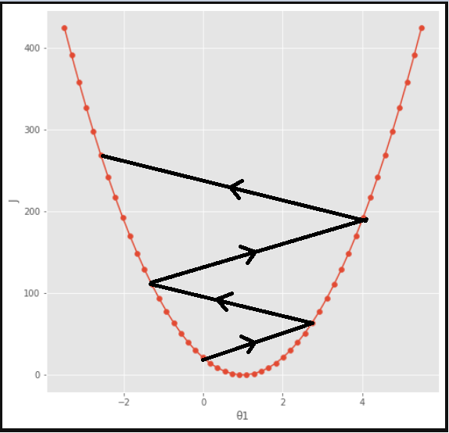
What about α?
Learning rate, so-called hyperparameter. Too high:
■
■
Source: Andrew Ng, Coursera
m
∑
Source: https://towardsdatascience.com/univariate- linear-regression-theory-and-practice-99329845e85d
_{(x}(i)_{)− y}(i)₎
∂
∂θ ₀
α
θ ₀=θ ₀−α
J (θ ₀ ,θ ₁)=θ ₀−
(h
m _{i}
θ
=1

Slide 118
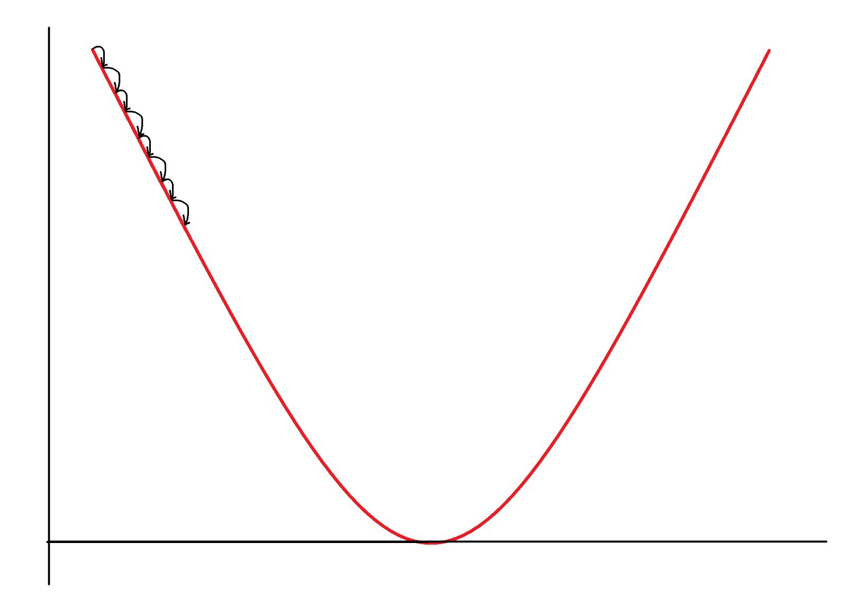
What about α?
Learning rate, so-called hyperparameter.
■
Too low:
■
Takes extremely long to converge!
J (θ ₀)
Source: Andrew Ng, Coursera
θ ₀
m
∂
∂θ ₀
J (θ ,θ )=θ − ^{α} ∑(h
_{(x}(i)_{)− y}(i)₎
θ =θ −α
0
0
0
1
0
m
θ
i=1

Slide 119
What about α?
Learning rate, so-called hyperparameter. Will discuss later how we pick it!
■
■
Source: Andrew Ng, Coursera

Slide 120
Summary
Defined a cost function for linear regression
Showed how gradient descent can be used to minimise this cost function by changing the parameters
Calculated partial derivatives for use with gradient descent
Encountered our first hyperparameter, α, which governs the size of update steps
■
■
■
■

Slide 121
Practicals
■
Feel free to add code cells to experiment in, and always experiment before putting something in a function!
Handy shortcuts:
■
Ctrl + Enter → run current code cell
Ctrl + b → add new cell below current cell Ctrl + a → add new cell above current cell
Esc + m → turns selected cell into a markdown cell (for writing notes) Shift tab: go one indentation level back on all selected lines
Tab: Go one indentation level deeper on all selected lines
–
–
–
–
–
–
–
You can toggle line numbers under View in the top menu bar.

Slide 122
Practicals
You should now open and do
Day1/Practical_1/PracticalMaterialDay1_ShortPractical1.ipynb
Open Anaconda prompt, navigate to BMLB2025, and type jupyter notebook. Then navigate to and open the correct file in this browser interface.
DuckDuckGo and Google are your friend: numpy takes some getting used to, so search, search, search!
I will start the next lecture in about an hour. If you’re not finished: don’t worry! Just continue where you left off after the lecture.
■
■
■
■

